Slide 1
The CYBERWISER.eu project
Antonio Álvarez Romero
Atos
CYBERWISER.eu 1st Webinar
14/02/2019

Slide 2
CYBERWISER.eu, in a nutshell
An H2020 Innovation Action aiming to develop a highly innovative cyber range platform for professional training.
Addressed to the future cybersecurity professionals in charge of defending their companies against increasingly aggressive cybercriminals
Contributing to the continuous development of a cybersecurity culture across the EU society with strong awareness creation in different social segments.
From September 2018 through February 2021.

Slide 3
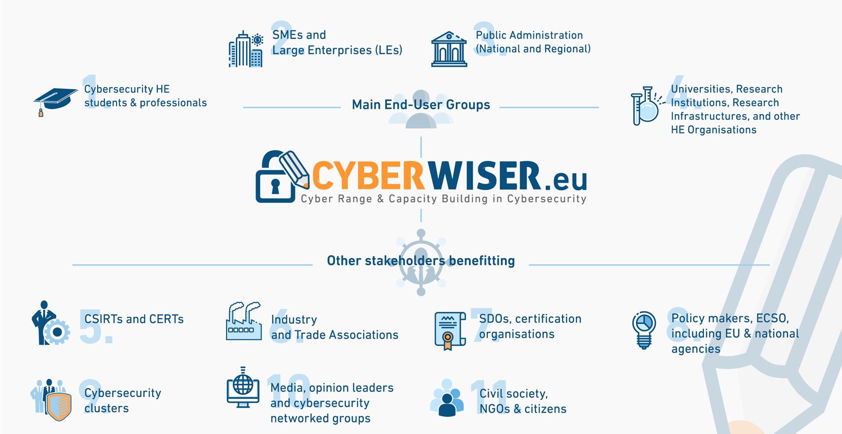
A wide range of stakeholders

Slide 4
Cybersecurity challenges
Increased dependence on ICT systems in any business from any sector.
Increasingly aggressive cyber-landscape.
Need for highly-skilled professionals to cope with the quick evolution of the attacks.
It is really difficult to catch up with the black-hat hackers
Need for better training capabilities.
How to train highly-skilled and reliable cybersecurity professionals?
Exercises need to be as immersive as possible
The trainee needs accurate simulations of the environment they will protect, with as many details as possible
The trainee needs exercises basing on situations he/she is likely to live in person in his real job, in which a quick reaction will be demanded in the context of an urgent scenario
These environments are found difficult to afford in general

Slide 5
CYBERWISER.eu Objectives
Deliver a European Platform for cybersecurity professional training
Innovative cybersecurity training tools and materials
Create robust & insightful economic models for monetary exposure assessment to risk in virulent cyber climates
3 full-scale pilots in key vertical markets & education and activate and manage the “Open Pilots Stream”.
Develop a sustainability model for the CYBERWISER.eu training platform.
Develop and run the "Cybersecurity Professional Register” to promote cybersecurity capacity building in Europe
Mission: CYBERWISER.eu will provide a simulated environment to create cyber incident and cyber attacks scenarios where both students and IT professionals evolve their skills and continuously evaluate their performance, getting ready for future real attack episodes.

Slide 6
Platform & components

Slide 7
3 Full Scale Pilots supporting validation
Energy Generation
And Distribution
Railroad Transport
Professional And
Academic Training

Slide 8
Main expected results
Training materials with methodology and guidelines for the generation of exercise scenarios
Tools to generate highly-detailed exercise scenarios
Digital Library with relevant and useful scenario “bricks”
Tools to participate in the exercise as an attacker or defender
Innovative tools for monitoring and tracking the evolution of an exercise
Security monitoring tools
Cyber risk economic evaluator
Methodology for user performance evaluation
Real-time user performance evaluator
Generation of wide social impact
Addressing to the general public
Primer version focused on this with a strong gaming approach

Slide 9
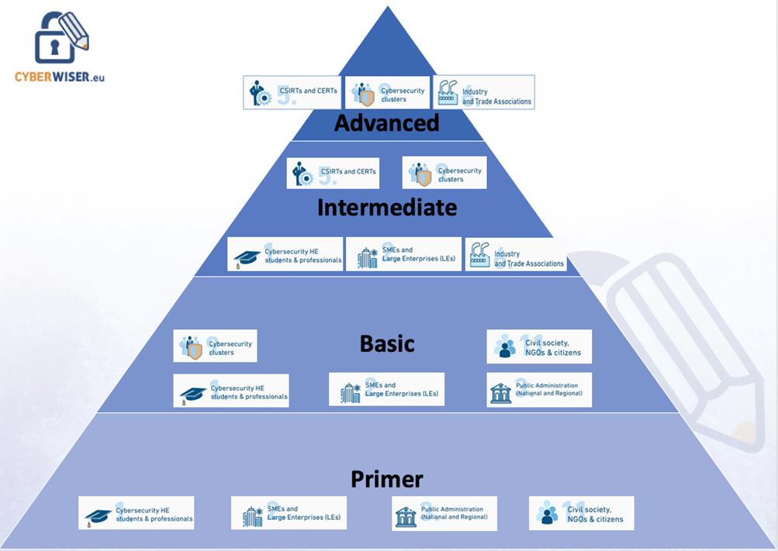
CYBERWISER.eu offering

Slide 10
Thank you for your attention! Questions?
Main contact:
Antonio Álvarez, antonio.alvarez@atos.net
Organisation:
Atos

