Slide 1



Matteo Merialdo
RHEA Group
Innovative aspects in cyber range solutions

Slide 2
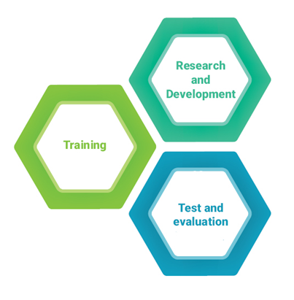
Cyber Range – Key Concepts
What is a Cyber Range?
  A recent concept
  A multipurpose virtualization environment supporting three main needs:
    Knowledge development and dissemination (training)
    Improved system assurance in development (R&D)
    Improved system assurance through test and evaluation (testing)
  A safe environment for cyber attack scenario simulation and test

Slide 3
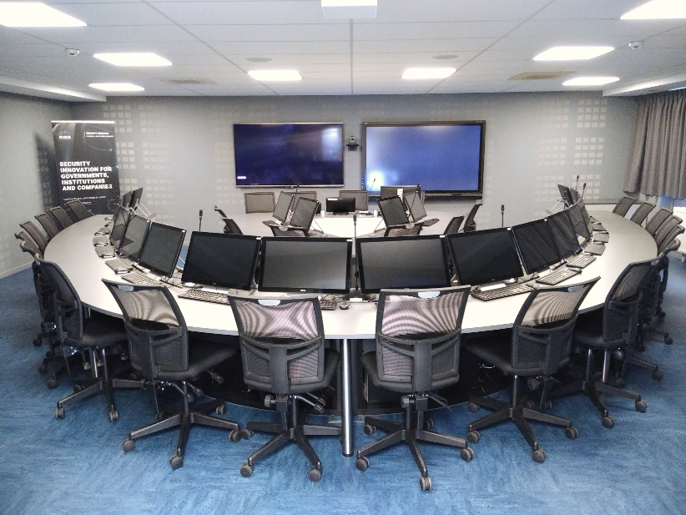
Cyber Range – Training
Cyber ranges are extremely suited for security training purposes
The virtual environments allow trainers and trainees to perform multiple realistic training scenarios with a fraction of cost and effort needed for building and configuring similar physical platforms
On next-generation ranges, the freedom of configuring and monitoring the training scenario in real-time is invaluable for trainers

Slide 4
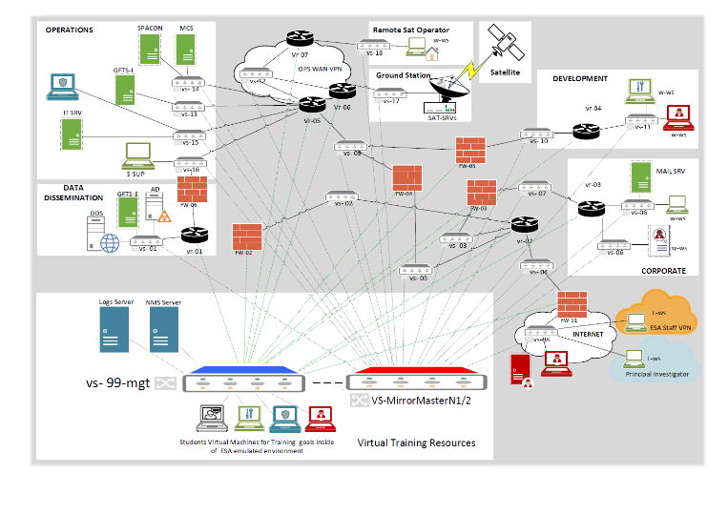
Cyber Range: Research and development
Reducing the cyber threat through emulation
All critical infrastructure systems are at risk of cyber security attacks. Being aware of the risks from early stages of system and software development is vital for building secure infrastructure.
The realistic emulation environment facilitates experimentation, evaluation of early prototypes and design verification testing.

Slide 5
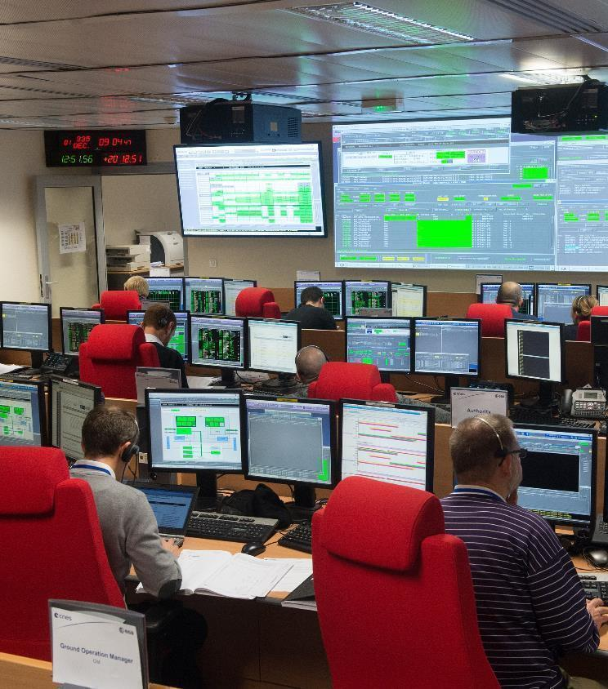
Cyber Range: Test and evaluation
Anticipating cyber threats with a realistic test framework
Cyber ranges provide frameworks where experts can analyse and examine cyber attack technologies under realistic conditions
Critical systems can be tested securely in a realistic test framework that facilitates incident management and response

Slide 6
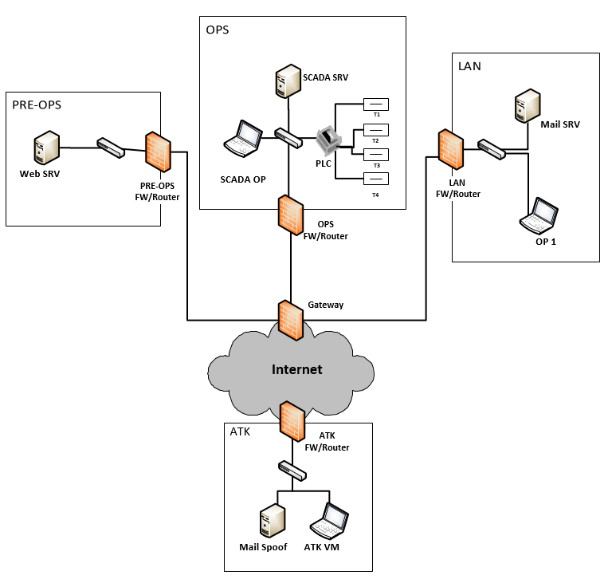
CYBERWISER.eu: a next generation cyber range
CYBERWISER.eu aims at becoming a reference cyber range platform for professional training for EU

Slide 7
CYBERWISER.eu: a next generation cyber range
The platform will leverage advanced features of next generation cyber ranges:
Detailed scenario design
Wide digital library for scenario variety
Virtual networks and routing semi-automatic configuration
Events scheduling during scenario design
Events triggering during scenario execution

Slide 8
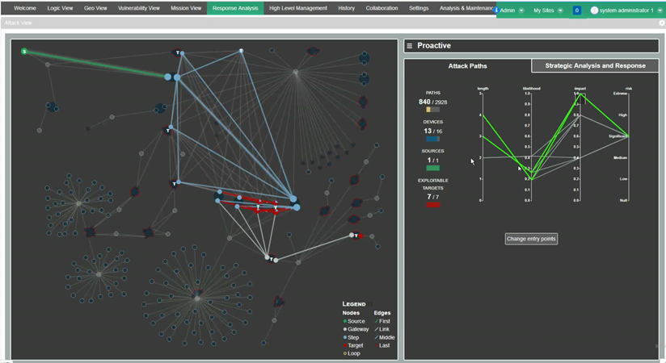
CYBERWISER.eu: a next generation cyber range
The platform will leverage advanced features of next generation cyber ranges:
Real-time overview of events in active scenarios
Automatic performance evaluation of trainees
Full suite of attacking and protective tools for complex scenario
Full suite of cross learning tools

Slide 9
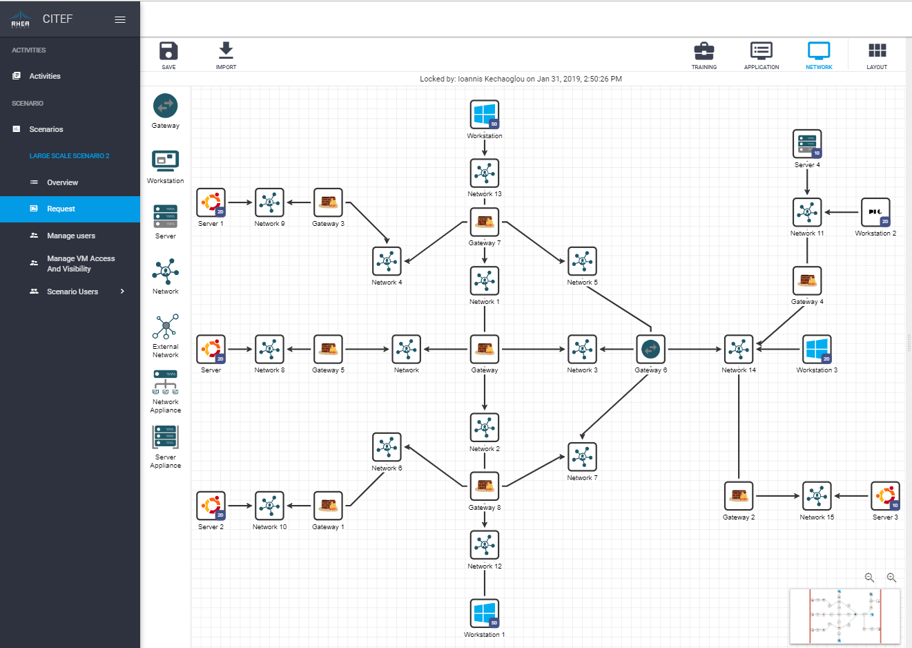

CYBERWISER.eu: based on existing advanced technologies
The core of CYBERWISER.eu is based on the Cyber Security, Test and Evaluation Framework (CITEF) platform
Developed by RHEA Group in the context of the first Cyber Security Centre of Excellence for the European Space Agency
A complete platform, CITEF allows CYBERWISER.eu to be already deployed on a preliminary version, leveraging on a set of consolidated features including
  Detailed scenario design
  Wide digital library for scenario variety
  Virtual networks and routing semi-automatic configuration
  Advanced flexibility on instantiation/deletion/update of complex scenario

Slide 10
CYBERWISER.eu: based on existing advanced technologies
The advanced training scenario features will be based on existing tools to be improved during the project:
  Monitoring Sensors (ATOS)
  XL-SIEM (ATOS) – anomaly detection
  Risk Assessment Engine (ATOS) – based on economic models from SINTEF
  Decision Support System (ATOS)
  xOpera (XLAB) – to support alternative IaaS
  xRuntime (XLAB) – full suite of attacking and scanning tools
  Cross-learning platform (Trust-IT)

Slide 11

Thank you for your attention! Questions?
Main contact:
Matteo Merialdo, m.merialdo@rheagroup.com
Organisation:
RHEA Group

