Slide 1
Liliana Ribeiro
EDP – Energias de Portugal, S.A.
Webinar
14 February 2019
CYBERWISER.eu on Critical Energy Infrastructures

Slide 3
ABOUT US
EDP in Numbers
EDP in the World
EDP IT in Numbers

Slide 4
AN ENERGY SECTOR LEADER COMPANY
We Are…
The largest electricity producer, distributor and retailer in Portugal
One of the largest European players on the energy sector (gas & electricity)
One of the largest energy players on Iberia
A world leader in the renewable energy market

Slide 5
IN NUMBERS
14
COUNTRIES
Portugal, Spain, Brazil, EUA, Canada, China, France, Belgium, Italy, Poland, Romania, UK, Angola, Mexico
11
Million
CUSTOMERS
9.7 million electricity customers | 1.4 million gas customers
12.084
EMPLOYEES
32 Nationalities | 23% women

Slide 6
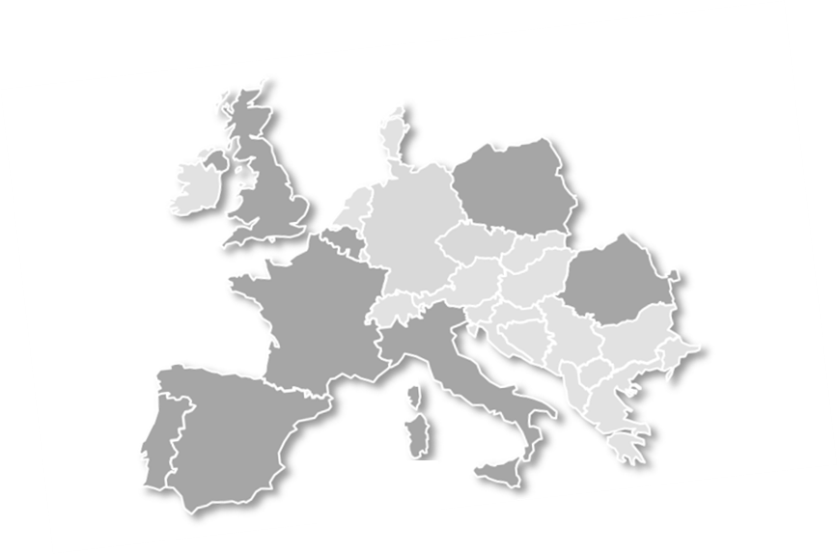
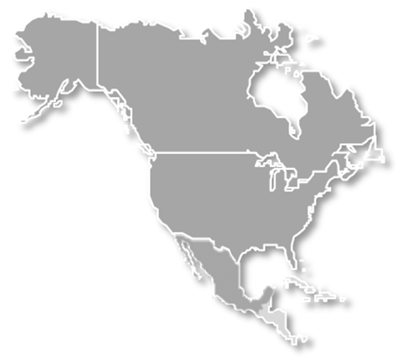
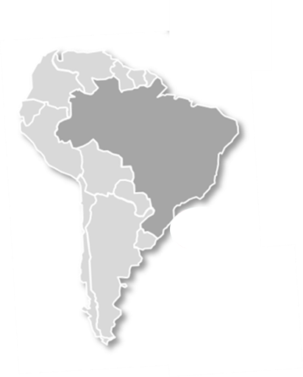
IN THE WORLD
EDP Group
Wind & Solar Power
EBITDA 2015: EBITDA: €3.8 B (> 60% ex-Portugal)
Installed Capacity: 24,4 GW
> 77% Renewable sources generation
# Locations: 14
# Customers: > 11 million
12% North America; 7% Portugal; 6% Spain; 4% Others (EBITDA)
IPO in June 2008
Solar & Wind installed Power: 9.3 GW
A world leader at renewables
EDP Brazil
22% of the EBITDA
Subsidiary: EDP Brazil (EDP holds 51%)
Presence since 1996
Energy generation: 2.5 GW (hydro and coal)
2 Energy distribution concession contract
Portugal
Espanha
36% of the EBITDA
Privatised since 1997
Only Energy distributor
Energy generation: 8.8 GW
(5.6 from hydro)
13% of the EBITDA
Presence since 2001
Energy generation: 3.8 GW
#2 in gas distribution

Slide 7
IT in NUMBERS
WAN – Links and accesses
21.713
Processing Capacity
258.000
ktpmc
&
0 MIPS
341 links
Users – internal and external in every worldwide location
Network capacity (Mbps)
DataCenter data volume
64.000
2.5PetaBytes
(aprox.)
Security incidents/events
Applications at DataCenters
287
2 DataCenters
(PT and ES)
DDoS avoided
441,2/month
Security incidents
11,1/month
Blocked virus attempts
8000/month
Managed Terminal Equipment
19.500+
in 14 countries
in 4 continents
187
Brazil

Slide 8
CYBERWISER.eu on Critical Energy Infrastrutures
Critical Energy Infrastructures
vital component of modern societies
integration of operational and information technologies (OT and IT)
legacy systems
Resilience against cyber-attacks is a major concern

Slide 9
CYBERWISER.eu on Critical Energy Infrastrutures
Company’s objectives:
awareness on cybersecurity;
perception of the impact of cyber-attacks in a physical environment;
crisis management, from preventive to reactive measures.

Slide 10
CYBERWISER.eu on Critical Energy Infrastrutures
Relevance of CYBERWISER.eu:
platform for cybersecurity training;
increase of the number of trainees;
possibility to involve different geographies;
development of defence and offense capabilities.
Cybersecurity is about cooperation and collaboration.

Slide 11
Thank you for your attention! Questions?
Main contact:
Liliana Ribeiro
EDP – Energias de Portugal, S.A.

