Slide 1
Antonio Álvarez Romero
ATOS
SQL Injection Webinar
22 September 2020 – 11:00 CEST

Slide 2
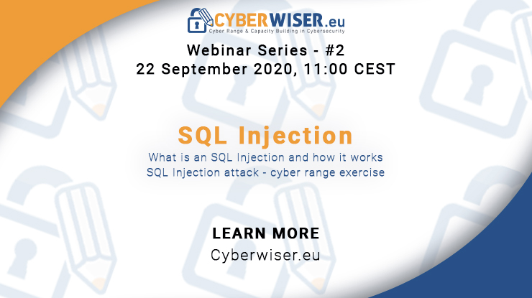
Agenda
11:00 - 11:10 ; Welcome and introduction to the Open Pilot Process – Antonio Álvarez Romero (ATOS)
11:10 - 11:15 ; Introduction to the CYBERWISER.eu Platform – Artem Korytnyi (ATOS)
11:15 - 11:20 ; Introduction to SQL Injection – Anze Zitnik (XLAB)
11:20 - 11:45 ; SQL Injection hands-on cyber range exercise – Anze Zitnik (XLAB), Guillermo Yuste (ATOS)
11:45 - 11:55 ; Q&A
11:55 - 12:00 ; Closing remark and open pilot reminder -Niccolò Zazzeri (Trust-IT Services) – Antonio Álvarez Romero (ATOS)

Slide 3
CYBERWISER.eu, in a nutshell
An H2020 Innovation Action aiming to become the EU’s reference, authoritative, independent cyber range platform for professional training.
From September 2018 through February 2021.
Featuring an open pilot stream, for you to get to use the CYBERWISER.eu platform (for free!) – pre-book your own pilot at https://cyberwiser.eu/content/open-pilot-stream

Slide 4
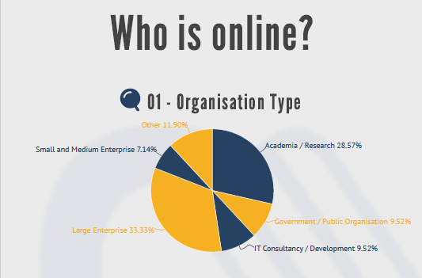
Who is online?

Slide 5
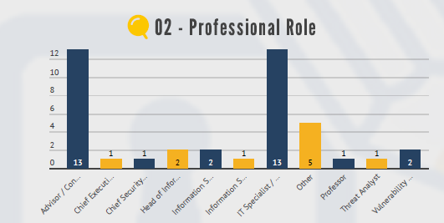
Who is online?

Slide 6
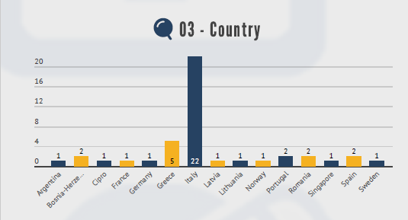
Who is online?

Slide 7
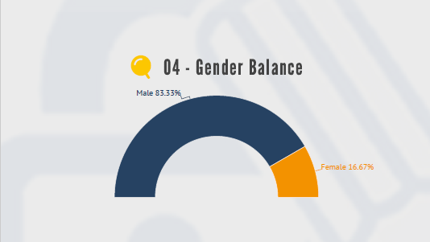
Who is online?

Slide 8
CYBERWISER.eu Open Pilot Scheme
Helping to increase cybersecurity skill levels for technical and non-technical staff
Customisable
Open to any European organisation at no cost apart from investment in time and resources
www.cyberwiser.eu/content/cyberwisereu-open-pilot-scheme

Slide 9
Step 1: user requirements
What information we need from you: the specs for your pilot

Slide 10
Step 2: Enrollment of pilot users & scheduling of the pilot
Give us the list of trainees
We will prepare your pilot
Fig.1 How to access the Platform
Fig.2 Workspace

Slide 11
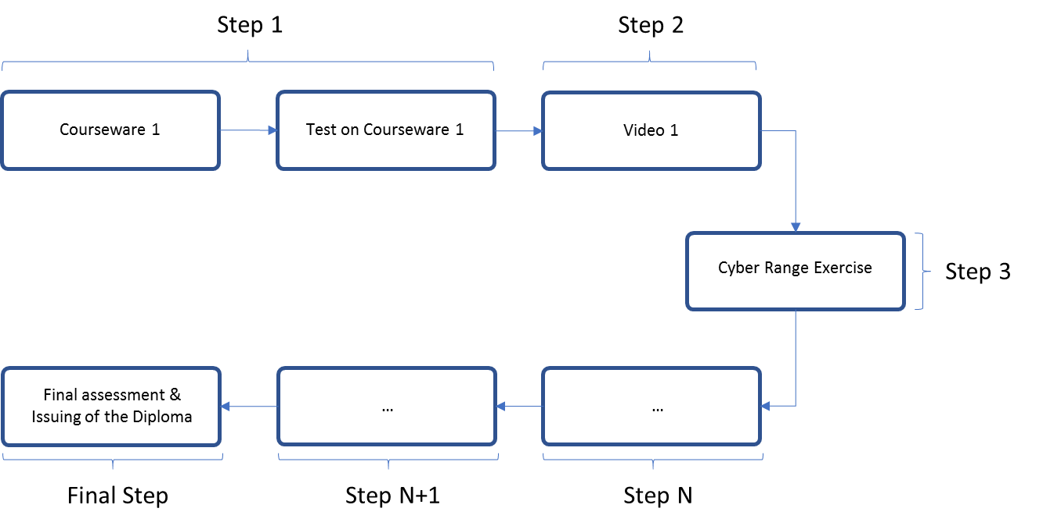
Step 3: Pilot
After the registration, we will define the overall schedule for the training courses
(Learning Path = Online + webinars + classrooms + cyber range tests + assessment test)

Slide 12
Step 4: After the courses completion
You will have acquired highly-demanded cybersecurity skills
You will be ready to promptly and adequately react to cyber incidents, if you are targeted by cyber crime
But don´t forget that cyber resilience is a journey, not a destination
You will always have to keep learning and evolving your cybersecurity abilities. Cyber criminals keep forever challenging us with new types of attacks
Advanced users will be inserted in the Cybersecurity Professional Register(CyPR)

