Slide 1
Anže Žitnik
XLAB
SQL Injection
22 September 2020

Slide 2
SQL injection
Attack type targeting database-backed applications
SQL statements inserted as input and run by the application
Parameters, form input, URL, cookies...
Most common web application attack
First mentioned in 1998
Injection #1 on OWASP Top 10 since 2010

Slide 3
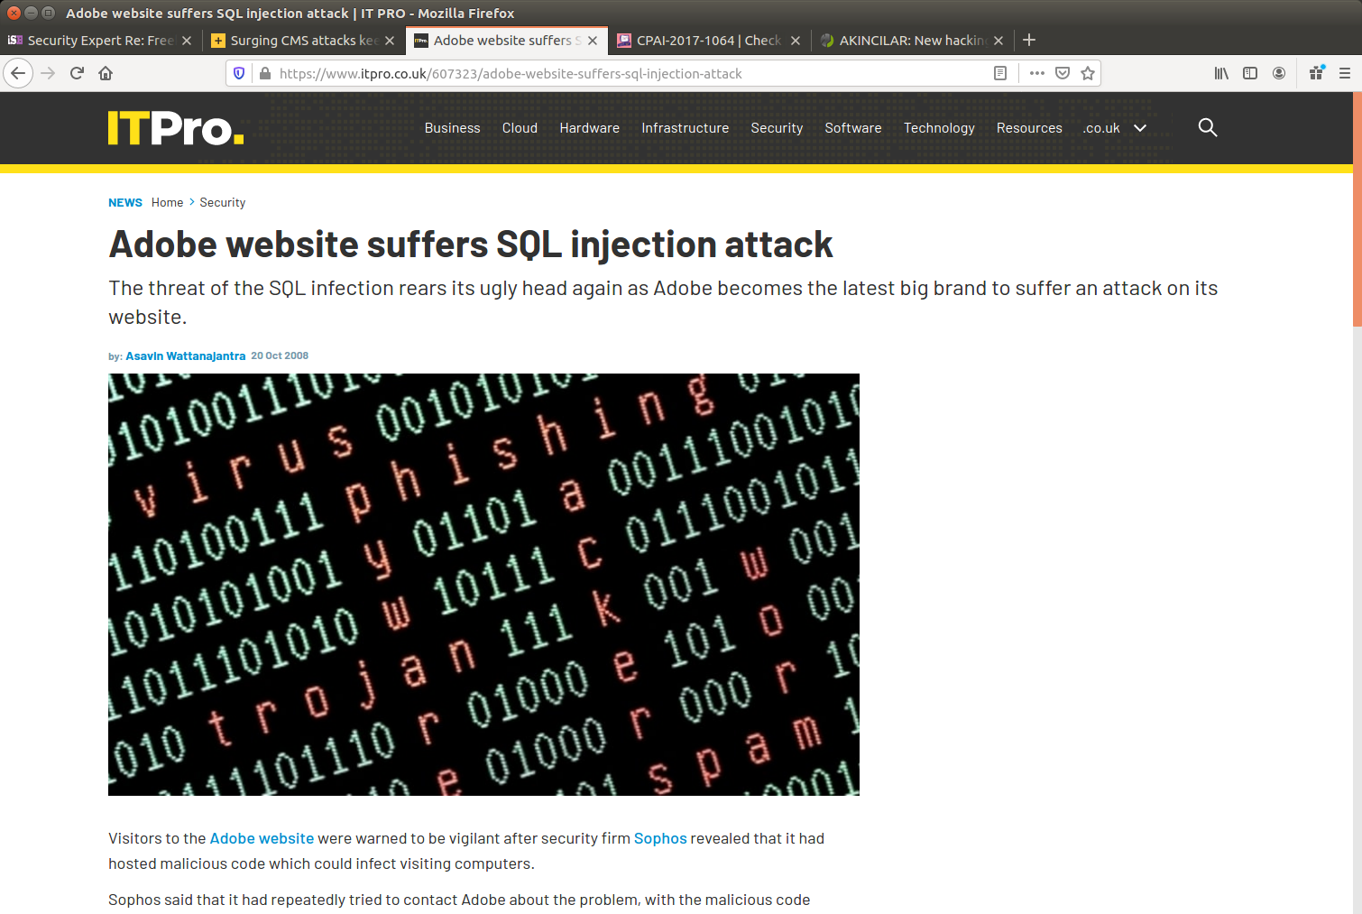
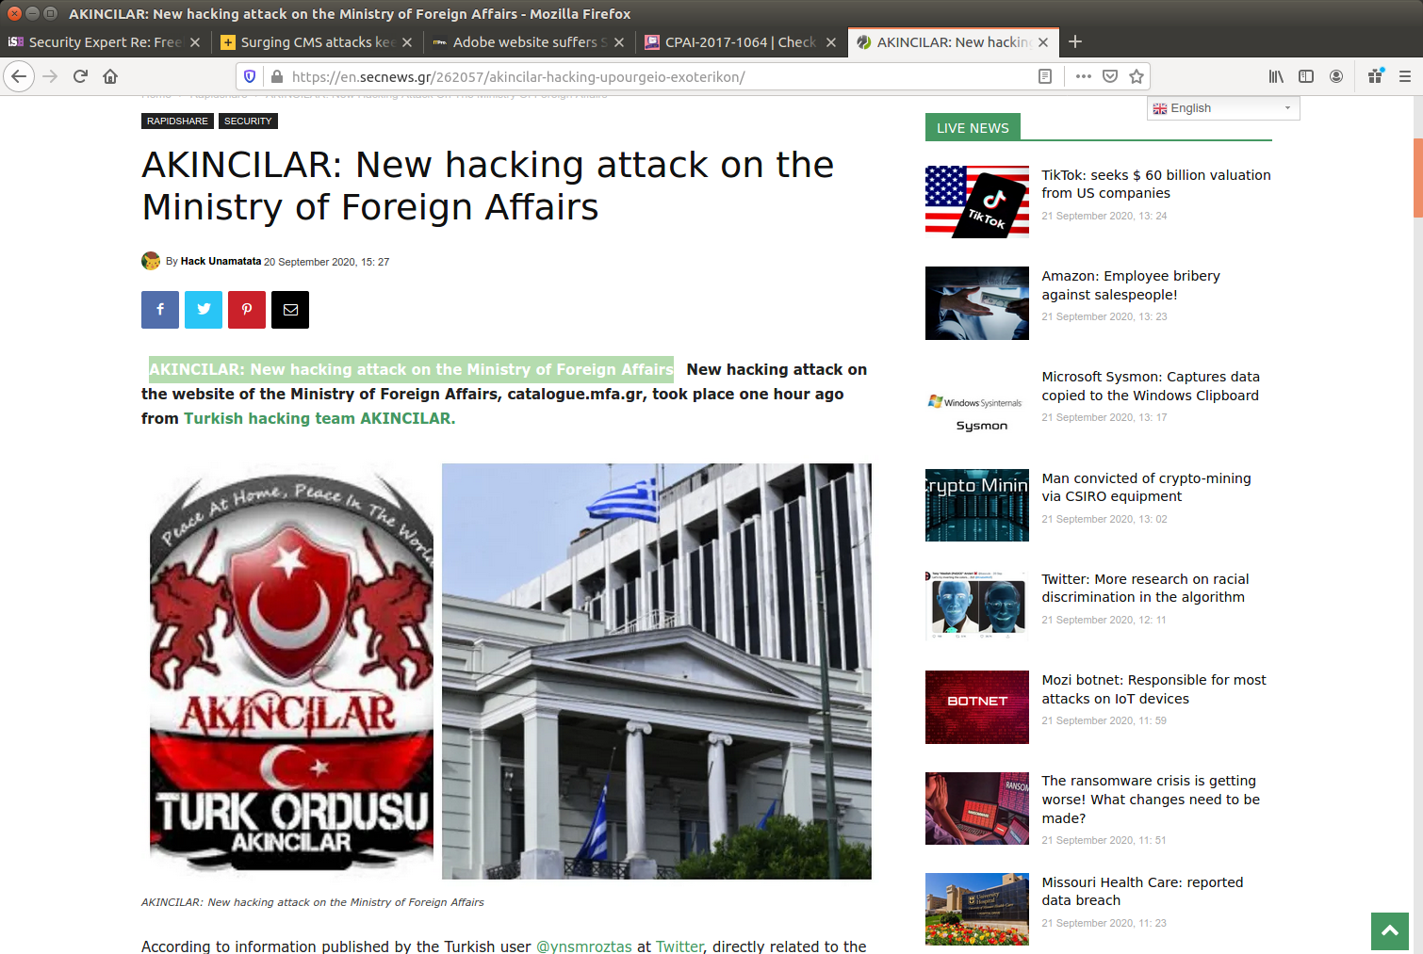
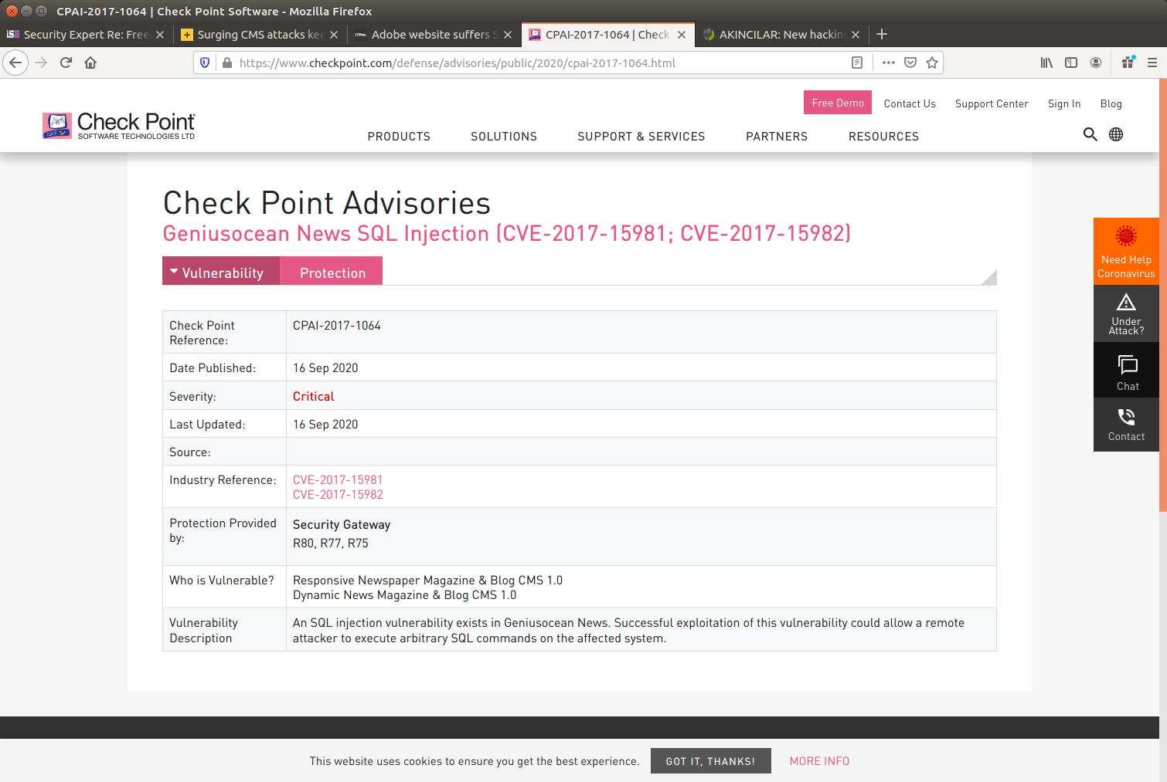
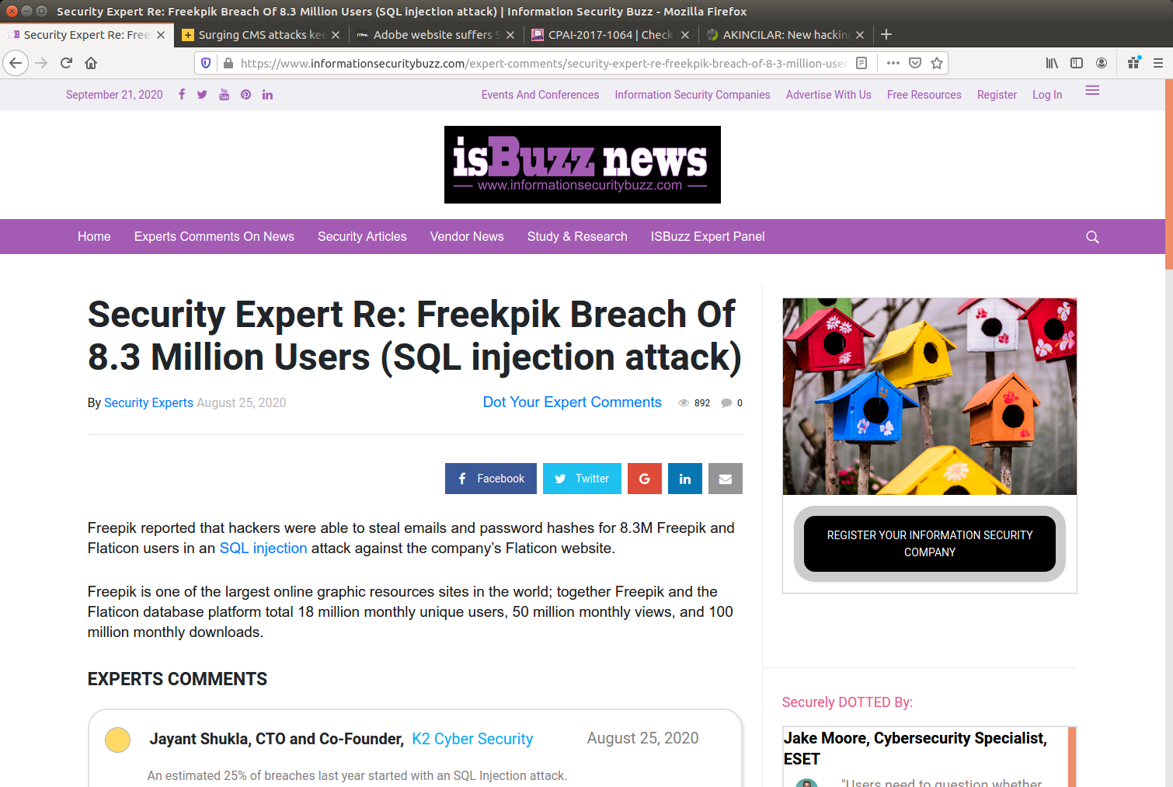
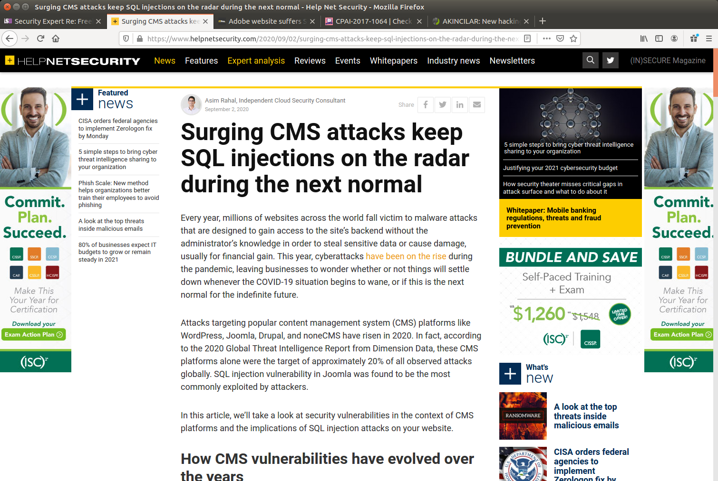
SQL injection: latest attacks

Slide 4
SQL injection: example
Example code:
Example URL: http://example.com/app/accountView?id=’ or ‘1’=’1
Resulting query:
Modify, delete data, call arbitrary code (DB and system!)
String query = “SELECT * FROM accounts WHERE custID = ’” + request.getParameter(“id”) + “’”;
SELECT * FROM accounts WHERE custID = ’’ or ‘1’=‘1’

Slide 5
SQL injection: prevention
Sanitize, verify inputs (server side)
Escape special characters
Use ORM frameworks
Limit access as much as possible (permissions for DB user)
Include security testing in development/release
Regularly update CMS (WordPress, Drupal, Joomla)

Slide 6
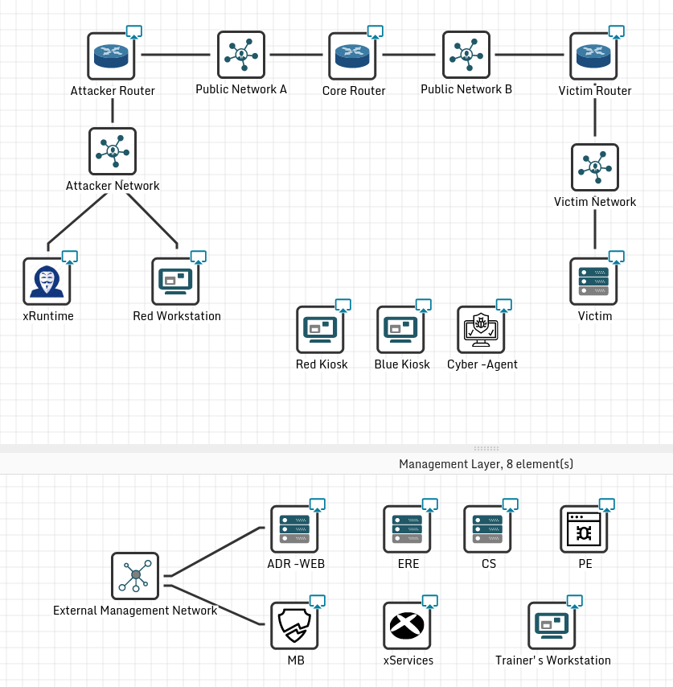
Demo
SQL injection
Red team and blue team
CYBERWISER.eu tools
Red team:
Can use prepared vuln. detection script
Goal: Exploit SQLi to find secret flag
Blue team:
Can use tools for attack detection, risk assessment
Goal: Choose correct mitigation among the offered ones

Slide 7
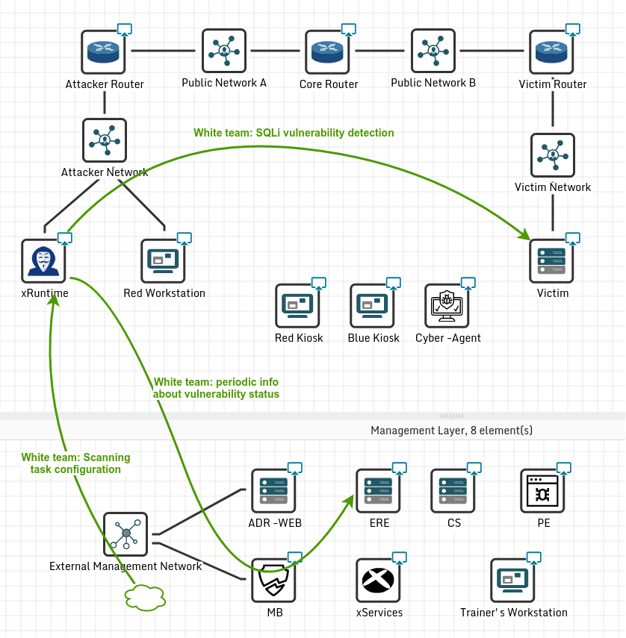
Demo

Slide 8
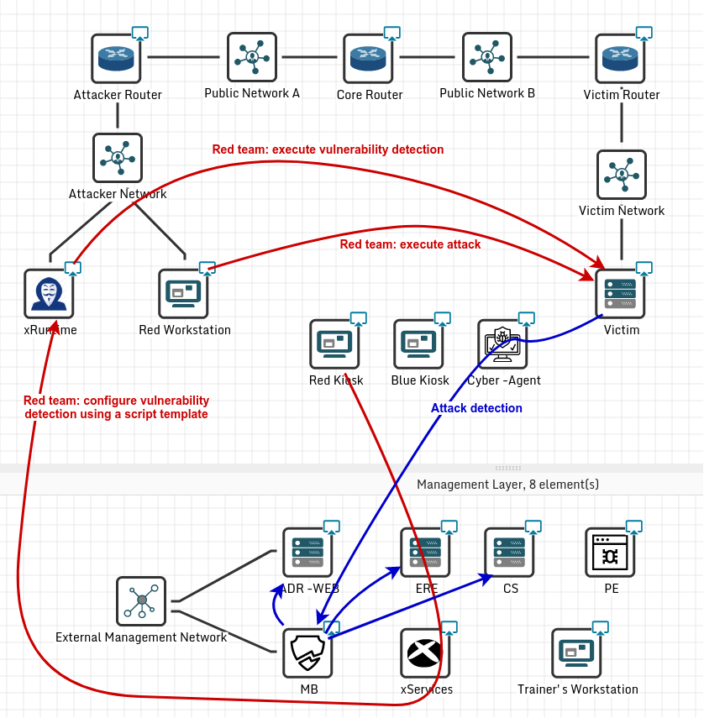
Demo

Slide 9
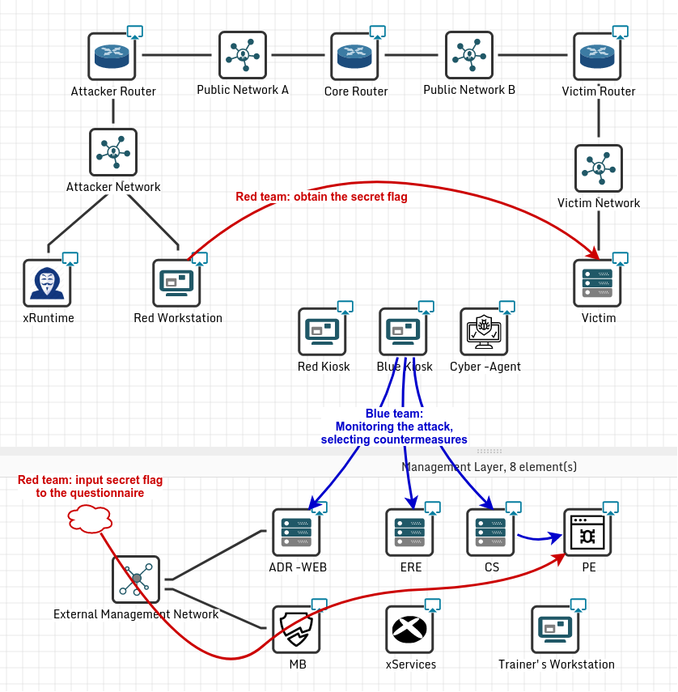
Demo

Slide 10
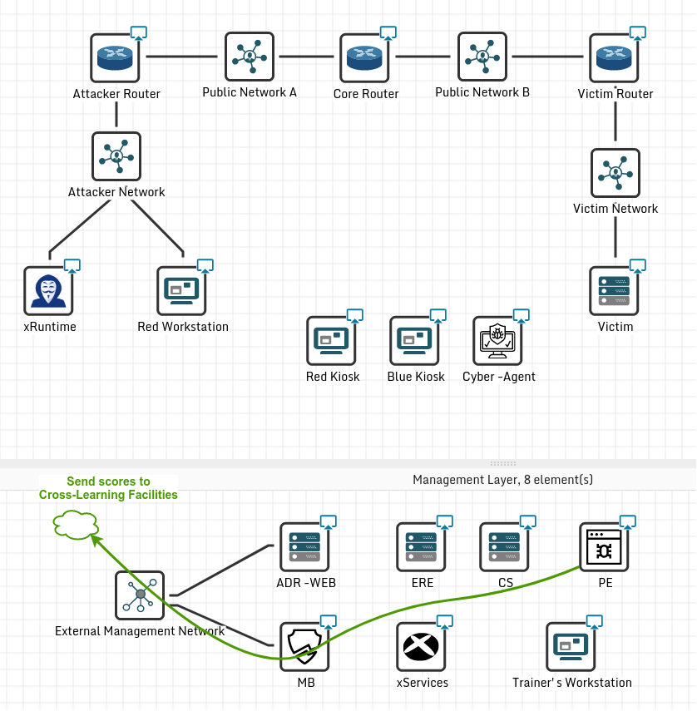
Demo

Slide 11
Thank you for your attention! Questions?
Main contact:
Anže Žitnik
XLAB
anze.zitnik@xlab.si

