Slide 1
Continuous monitoring of patients - anytime , anywhere, in hospital and at home

Slide 2
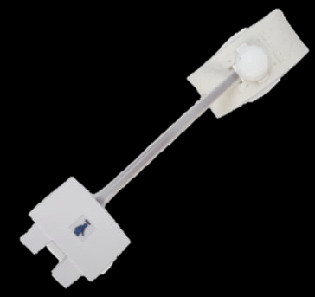
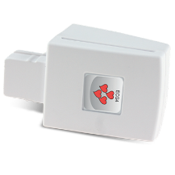
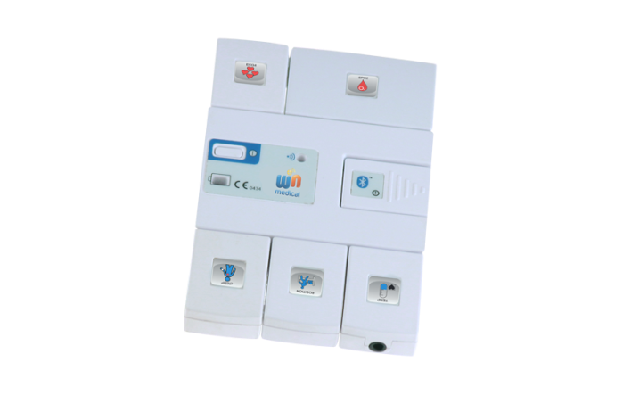
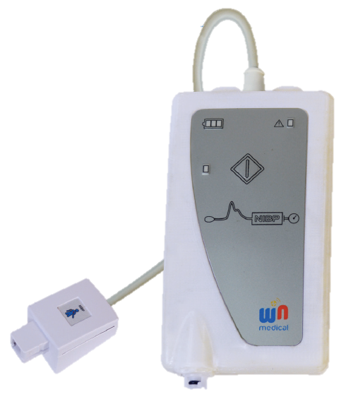
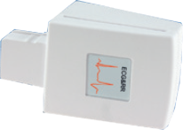
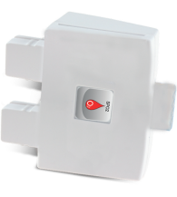
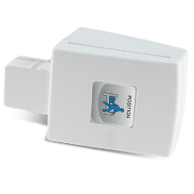
Is the most comprehensive wearable and modular system
for real-time, continuous and simultaneous vital signs monitoring in non-critical care units and at home, via Bluetooth or Wi-Fi
5-Lead ECG
cNIBP
5-Lead ECG with
Arrhythmia detection & Respiration Rate
2-Lead ECG & Heart Rate
NIBP
SpO2 and Pulse Rate
Position
Temperature

Slide 3
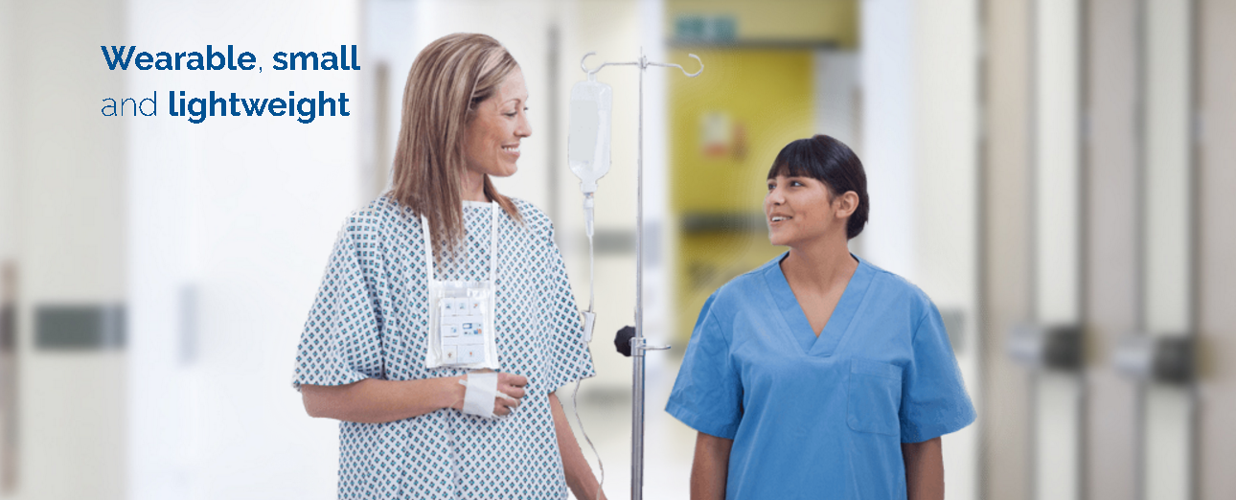
WinPack keeps patients continuously monitored

Slide 4
WinPack: Vital signs data and alerts can be accessed anywhere, at any time and on any device by the medical staff

Slide 5
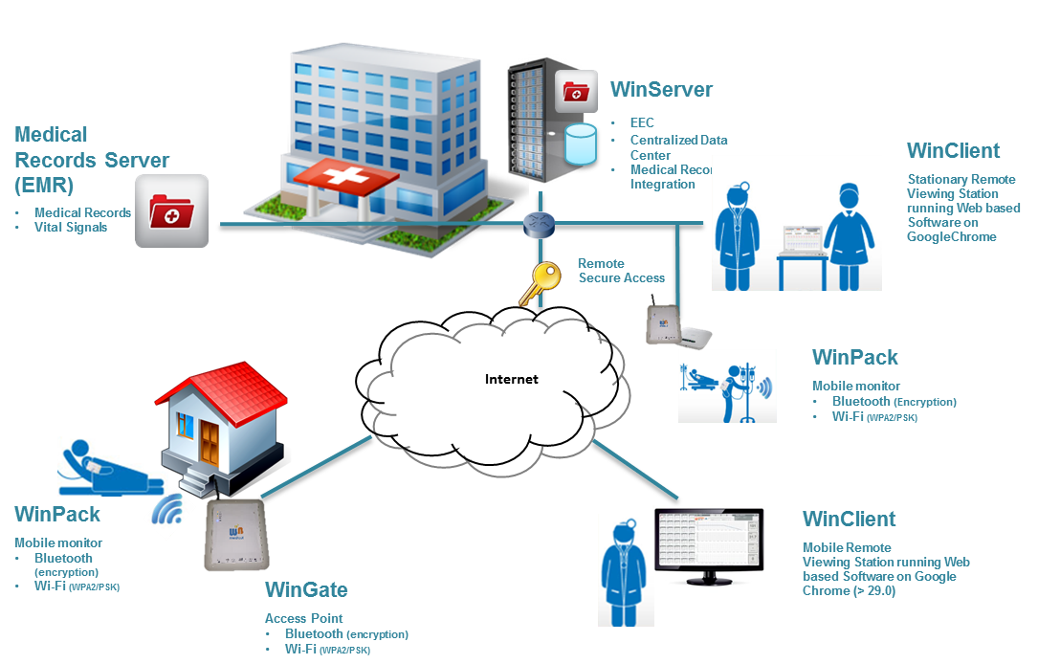
WINMedical System - Architecture
The proposed architectures are:
Win@Hospital
Win@Home
There are a lot of similarities between the two architectures. Both of them are composed of three basic components:
One or more WinPack devices acquiring patient vital signs
One or more WinGateways receiving and forwarding data from the WinPack to WINServer
A WINServer with Early Evaluation Center (EEC) software acquiring, storing and managing the received data and exposing a web interface for the clients (web-client application)

Slide 6
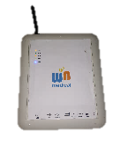
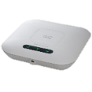
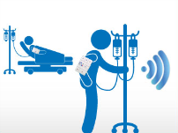
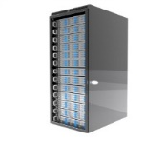
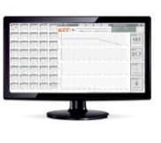
WIN@Hospital – Interoperability
WinGate
Access Point
Bluetooth (encryption)
Wi-Fi (WPA2/PSK)
WinMR
Medical Records Integration
Electronic Medical Record Server
WinServer
EEC
Centralized Data Center
Medical Records Integration
WinPack
Mobile monitor
Bluetooth (encryption)
Wi-Fi (WPA2/PSK)
Hospital Backbone
WinClient
Stationary Remote
Viewing Station running Web based Software on GoogleChrome
WinClient
Mobile Remote
Viewing Station running Web based Software on GoogleChrome
WINMedical developed a proprietary API allowing third parts software (3PS), such as Electronic Medical records (EMR), to manage medical records of monitored patients.
Furthermore 3PS can access to WINPack mobile vital signs by communicating with the WINMR software module.
WINMR will manage multiple requests of 3PS through a easy-to-use communication protocol.

Slide 7
Digital Health applications
Various types of “telehealth” have been applied in the past years and they can be summarized as the following:
• Telepresence: Live, two-way interaction between a person (patient, caregiver, or provider) and a provider using audiovisual telecommunications technology.
• Offline monitoring: stream of recorder heatlh records (ECG traces, glicemia or other physiological parameter etc.) sent by electronics communications systems to Physicians or other specialist in order to evaluate the case or render a service outside of a real-time or live interaction or refine treatements.
• Remote patient monitoring: Personal health and medical data collection from an individual in one location via electronic communication technologies, which is transmitted to a provider (sometimes via a data processing service) in a different location for use in care and related support.
• Mobile health (mHealth): Health care and public health practice and education supported by mobile communication devices such as cell phones, tablet computers, and PDAs. Applications can range from targeted text messages that promote healthy behavior to wide-scale alerts about disease outbreaks, to name a few examples.

Slide 8
WinMedical and information security
The WinPack is a class IIA continuous monitoring medical device:
Data shall be accurate
Data may be not in real-time
Alerts can be delayed
The EEC software stores personal data only as reference to clinical data and can transmits data to EMR systems (Directive 1995/46/EC).
The WinPack system can avail of distributed installations and data can flow through several information layers (e-Privacy Directive 2002/58/EC).
Data security is a priority for WinMedical in order to assure the reliability of the monitoring and security of personal data stored in its servers.
In order to expand its market to the US market the HIPAA guidelines shall be followed for individually identifiable health data.
GDPR is approaching and health providers are increasing cyber security requests.

Slide 9
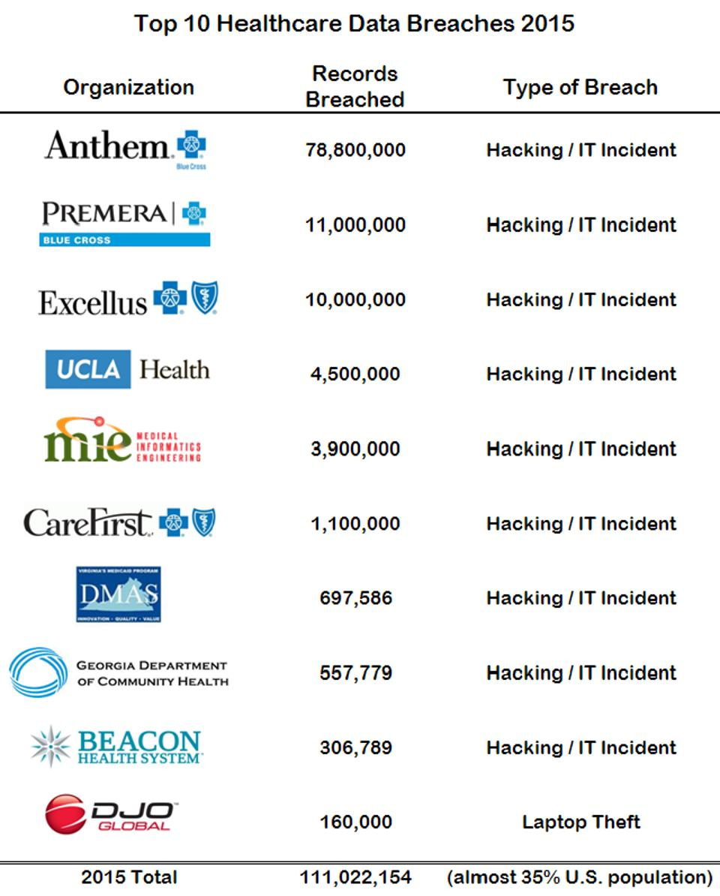
Cyber security in medical devices
Forbes presents an interesting list of the most important data breaches in healthcare in 2015 that totalled over 112 Million records.
Among the major violations reported was the TRICARE Management Activity, the Defense Department's healthcare program, which recorded 4.9 million records lost when tape backups were unavailable.
Other major breaches include: Health Net, which recorded 1.9 million records lost when discs were missing; The North Bronx Healthcare Network of New York City Health & Hospitals Corporation, which reported the theft of 1.7 million electronic medical recordings; AvMed health plans in Florida, which reported theft of a laptop with 1.22 million record patients; And Blue Cross Blue Shield of Tennessee, who reported theft of an external hard drive with 1.02 million records.
Since 2009 about 55.000 violation have been reported involving less than 500 records. Theft was 54% of violations, while hacking represented only 6% of compromised data. Theft was followed by unauthorized access or disclosure of 20%, lost records and appliances by 11%, elimination of records of 5% and other unknown categories about 4%.

Slide 10
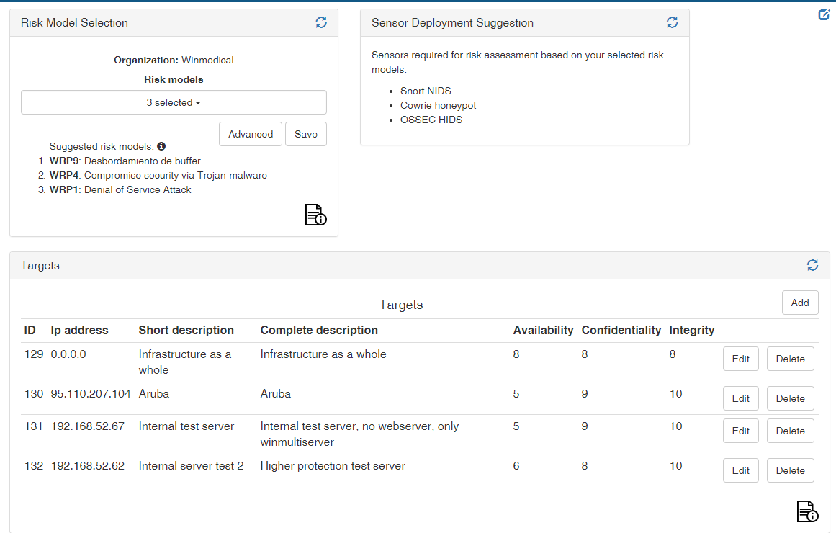
WinMedical and Wiser
Strengths:
Risk assessment support
Easy to use: focus on user experience
Identification of “weak spots”
State of the art cyber security expertise
Possible improvements:
Implementation of risk assessment based on ISO 14971:2012 approach
Risk Reporting centred on specific identified “weak spots”

Slide 11
WinMedical and Wiser
Why Wiser EAP: unique opportunity to work with an international consortium specialised in cyber-security
Security strategy: we have enlarged our horizon on security and became more aware of risks and opportunities
Wiser overtime: continuous interaction with EAP users, quick implementation of features, open mind approach to constructive criticism
Lessons learnt: never underestimate hackers’ creativity, stay on top of the game, profit from third party expertise

