Slide 1
Webinar
Free Cybersecurity Training with customised Learning Paths
22 April 2020, 15:00 CEST

Slide 2
Agenda
15:00-15:05 Welcome and Introduction to the CYBERWISER.eu Open Pilot Stream, Stephanie Parker, Trust-IT
15:05-15:10 Overview of the CYBERWISER.eu platform, Antonio Alvarez, Atos
15:10-15:20 Practical Guide on the CYBERWISER.eu Open Pilot Stream - Lorenzo Palai AON
15:20 – 15:50 CYBERWISER.eu platform in action: live demonstration with Niccolò Zazzeri, Trust-IT and Dario Varano, University of Pisa:
- Cross Learning Facilities demo
- Cross-site Scripting (XSS) exercise on cyber range demo
15:50-16:05 Q&A on The importance of cyber training and filling the skills gap with Csaba Virag, Cyber Services Plc, Member of the CYBERWISER.eu Stakeholder Expert Board and Panellists
16:05-16:15 Q&A with audience on the CYBERWISER.eu Open Pilot opportunities

Slide 3
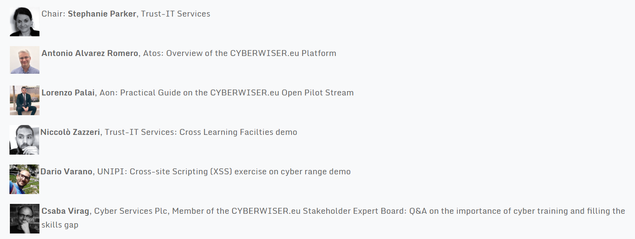
Panellists
Image fromTrust-IT pending

Slide 4
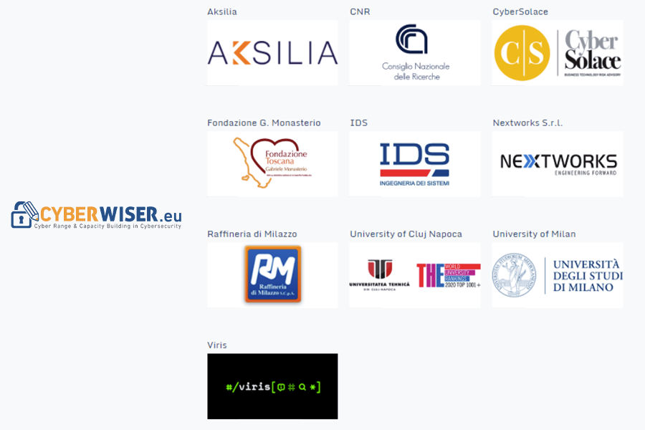
CYBERWISER.eu Open Pilot Scheme
Helping to increase cybersecurity skill levels for technical and non-technical staff
Customisable
Open to any European organisation at no cost apart from investment in time and resources

Slide 5
Overview of the CYBERWISER.eu Platform, Antonio Alvarez, Atos
CYBERWISER.eu is a cyber range platform envisioned to
Deliver cybersecurity professional training to a wide community
From students to experienced professionals
Public and private sectors
Applicable to different verticals
Provide with training tools and materials to cover both theory and practice
Learn how to attack to know how to defend
Put the user in the shoes of the attacker (red team) and the defender (blue team)
Promote and develop a solid cybersecurity culture across Europe and worldwide

Slide 6
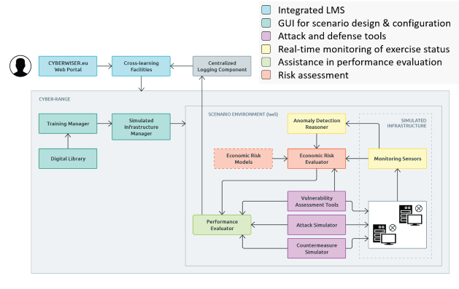
Overview of the CYBERWISER.eu Platform

Slide 7
Overview of the CYBERWISER.eu Platform
CYBERWISER.eu
PROVIDES | Training platform that includes a cyber range
 | High-Fidelity simulation of network infrastructures to be used as scenarios
 | Exercises, modules, courses and customized learning paths
 | Real-time monitoring of exercise progress
 | Real-time user performance evaluation
 | Management of individual learning path and curricula
ALLOWS | Theoretical training
 | Hands-on training
 | Learn from playing the role of both attacker and defender

Slide 8
Practical Guide on the CYBERWISER.eu Open Pilot Stream – Lorenzo Palai, Aon
What we will grant you as Open Pilot?
The opportunity to test the platform of training in cybersecurity for free
Onboarding package to use the platform (training material and dedicated interfaces)
Issued credentials to manage the instantiation of the platform for your specific Pilot, according to the training needs of a given technical profile
Continuous support by our Team
Lorenzo – add slides as needed

Slide 9
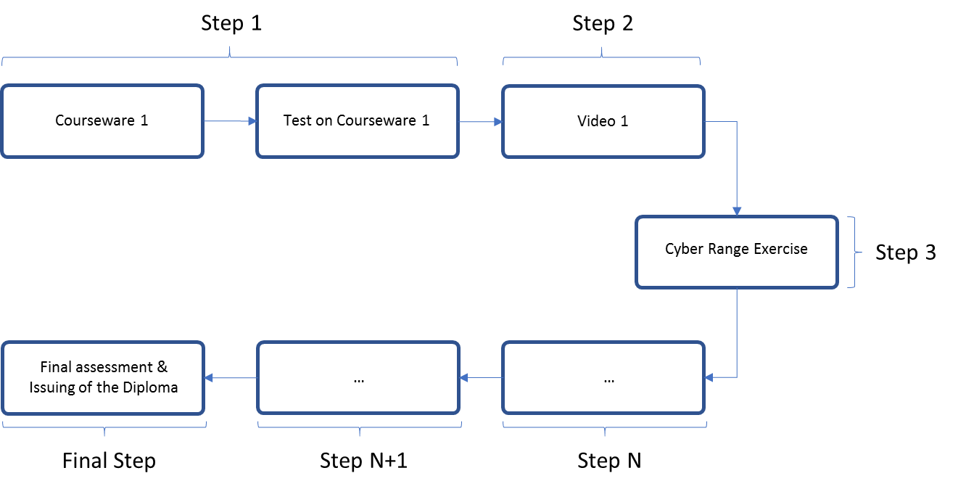
Practical Guide on the CYBERWISER.eu Open Pilot Stream
What is the learning pathway?
Learning Pathway = Set of modules included in a course
Lorenzo – add slides as needed

Slide 10
Practical Guide on the CYBERWISER.eu Open Pilot Stream
What are the practical steps to implement your Pilot?
Step 1: Enrollment
Open Pilots Workshop / Webinar
Online application
Step 2: Your training needs and requirements are collected
Step 3: Onboarding package provided to You (access to the training courses and platform)
Step 4: Training
Step 5: You gain a certificate of completion and access to CyPR
Lorenzo – add slides as needed

Slide 11
Practical Guide on the CYBERWISER.eu Open Pilot Stream
What are the advantages of being an Open Pilot?
The open pilot highlights:
what cyber risks may look like
where gaps need to be filled
The impact is:
greater engagement with senior management
showing how investment in cybersecurity reduce risks where it is relevant
a certificate of participation attesting the activities you have done
Lorenzo – add slides as needed

Slide 12
Introduction of the platform and live demonstration
Niccolò Zazzeri, Trust-IT and Dario Varano, University of Pisa:
- Cross Learning Facilities demo
- Cross-site Scripting (XSS) exercise on cyber range demo

Slide 13
Q&A: The importance of cyber training and filling the skills gap – Csaba Virag, SEB Member & Panellists
WORK IN PROGRESS
Poll on cyber range before starting
Q&A with panellists:
Can you talk us through the original use of cyber range?
How has it evolved in recent years?
How are its different application areas affecting its uptake, the general perception of cyber range?
How important is it to customise learning paths?
What takeaways are emerging from the use of cyber range by students at the University of Pisa?

Slide 14
Main takeaways
Today, you’ve seen:
How the open pilot scheme benefits your organisation, however large or small.
How to apply and how to share your technical requirements.
How the platform works in practice.
How the platform combines theoretical and hands-on approaches to assess your knowledge and build your skills.
How to benefit from customisation so your learning paths can be tailored to different levels and targeted skill sets.
The threat is significant to all companies and organisations dependent on IT. And these days - this is all companies and organisations, Troels Oerting, Chairman of the Board of World Economic Forums Centre for Cybersecurity (C4C), World Economic Forum

Slide 15
Thank you for your attention! Post-webinar Actions
Apply to become a CYBERWISER.eu Open Pilot
View our post-webinar online report
Access the presentations & recording
Share takeaways with colleagues
Join our community:
Follow us on Twitter (@cyberwiser) and LinkedIn (linkedin.com/company/42312614)
Subscribe to our Newsletter (https://www.cyberwiser.eu/newsletter-subscription)

Slide 16
Back-up slides (e.g. on the Platform)
Paid services
Advanced
Intermediate
Basic
Primer
What are the offering levels?
Pyramidal scheme of offering
Freemium services
Paid services
Package solutions
Freemium service

